Slide 1
Air Quality Prediction using Ensemble Classifiers and Single Decision Tree
Authors: Tanisha Madan, Shrddha Sagar, Tien Anh Tran, Deepali Virmani, Deependra Rastogi.
Published in: Journal of Advanced Research in Applied Sciences and Engineering Technology, 2025
Presented by:
Presented to:
Md. Shariful Islam
Lecturer
Department of CSE, DIU
Md. Soumik Hasan
Roll: 34
Md. Shariar Bin Sajjad
Roll: 29

Slide 2
Abstract
Air pollution has become a major environmental threat.
Dataset from OpenWeather API.
Models: Bagging, Boosting, Extra Trees, Decision Tree.
Best Accuracy: Gradient Boosting (98.89%).

Slide 3
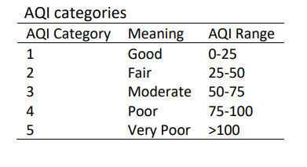
Introduction
Pollutants: CO, NO2, SO2, O3, PM2.5, PM10.
AQI Levels:
Dataset size: 5712 rows from Indian cities (Chandigarh & Visakhapatnam).

Slide 4
Literature Review
1. Su (2020)
    Used LightGBM and XGBoost for PM2.5 prediction.
    Found LightGBM performs better for accuracy.
2. Kothandaraman et al. (2022)
    Linear regression, random forest, KNN, AdaBoost, XGBoost
    Compare the results in terms of MAE and RMSE.
3. Zheng et al. (2020):
    Compared RF, LR, Boosting
    Ensemble models outperform traditional models

Slide 5
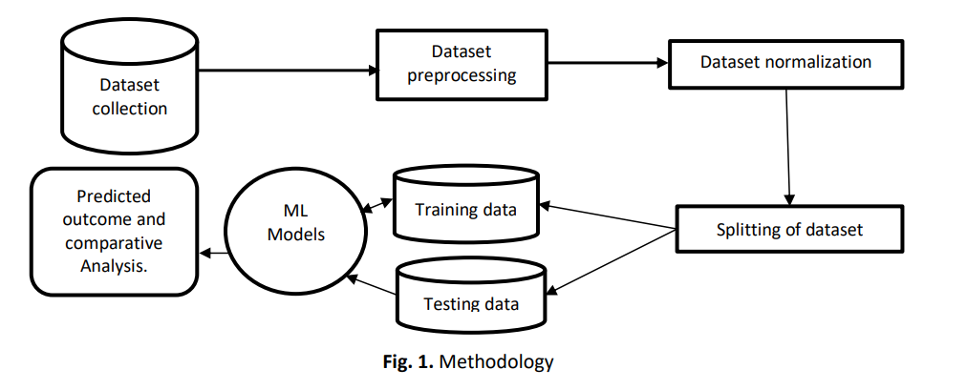
Methodology Workflow
OpenWeather
API
Train-test split (70/30)
Bagging Classifier
AdaBoost
Gradient Boosting
Decision Tree
Extra Trees

Slide 6
Results Summary
Model | Accuracy | Precision | Recall | F1-Score
Extra Trees | 98.48% | 0.9737 | 0.9752 | 0.9744
Gradient Boosting | 98.89% | 0.9740 | 0.9825 | 0.9781
Decision Tree | 98.42% | 0.9738 | 0.9639 | 0.9687
Bagging | 97.84% | 0.9534 | 0.9564 | 0.9543
AdaBoost | 85.01% | 0.4761 | 0.5946 | 0.5081

Slide 7
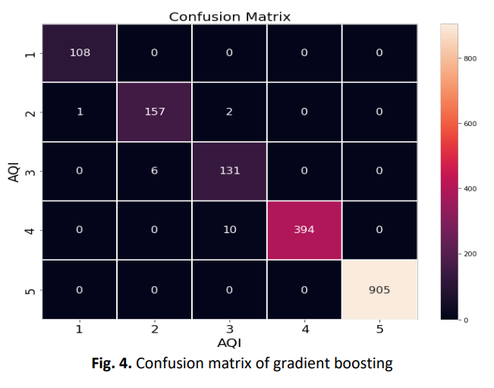
Confusion Matrix
Gradient Boosting achieved highest performance.

Slide 8

Gaps & Limitations
Did not use hyperparameter tuning and ROC curve.
Lack of Explainable AI (XAI) techniques for interpreting model decisions.
Did not relate or analyze health risks associated with specific air pollution levels.

Slide 9

Our Future Work
Achieved high performance with ML models using hyperparameter tuning.
Applied XAI for interpretability and feature importance analysis.
Focused solely on AQI prediction, avoiding health-risk assumptions.
Used clean pollutant-feature dataset for reliable forecasting.

Slide 10


